Slide 1
First Meet in Zijian’s Group
Zijian Ling

Slide 2
Outline
Warm up
Studying
Living
Intern in 2022 Summer
Further study
QA

Slide 3
Warm Up
https://georgelingzj.github.io/personal-page/
Introduction

Slide 4
Studying in UK
Module(random sort)
AIM: artificial intelligence methods
ACE: algorithms correctness and efficiency
OSC: operating system and concurrency
DMS: developing maintainable software
GRP: Group work
LAC: language and computation
CPP: C++
IIP: image processing

Slide 5
Studying in UK
Online exam
Limited time
Slightly harder than offline exam
GPA/Mark

Slide 6
Living in UK – when you arrive
University registration
Police registration
Based on your address,
34 pounds
Bank
Lloyds bank – 1 week
NHS

Slide 7
Living in UK – helpful App
Shopping
Amazon(6months student prime), UNIDAYS
Tesco – Groceries,
PayPal, bank app
Transport
Trainline – train; Railcard – discount on train ticket, National Rail – more official train ticket app
NCTX Buses – bus ticket in Nottingham
Health
NHS COVID-19
Food
Uber Eats, Deliveroo, Just Eat,

Slide 8
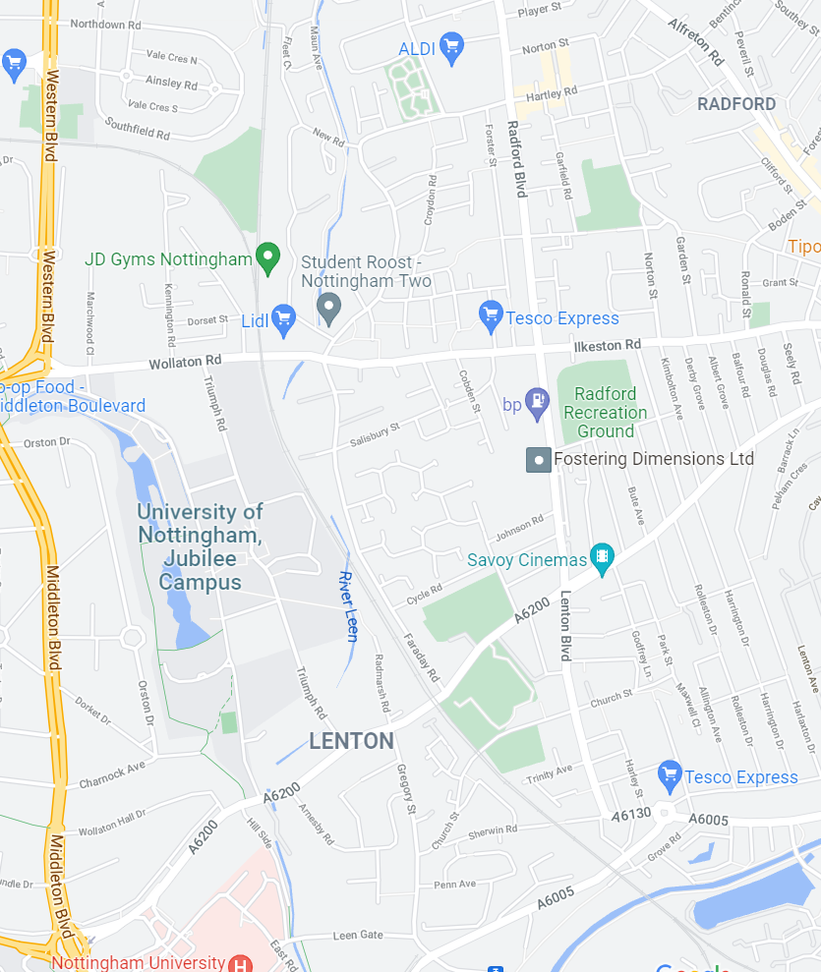
Living in UK - Nottingham
Eat
Downtown
Victoria Center(Bus 28, opposite from MV)
Jubilee
Lidl, ALDI, Tesco Express, Dominos
Beeston
Big Tesco(Bus 36)
Play
Sports
Jubilee Sports center
Park Sports center

Slide 9
Living in UK - transport
Bus
Tram
Train
Plane
London, Manchester
Drive
Chinese driving license – 1 year from entry

Slide 10
Intern - prepare
CV
GRP – lecture
Project
Where to find
LinkedIn
牛客(China)
Personal page(more about research intern)
When to find
UK: now – probably early Feb.
China: later Feb. – early Apr.

Slide 11
Intern
Software development engineer intern
Research intern

Slide 12
Further study
Master
1
Taught
Research
2(common)
UK, HK, Australia
US, Canada
Europe
PhD

Slide 13
Further study - prepare
In-class
GPA
Module coursework
Out of University
Intern experience
Project experience
Skills(programming language, framework…)
Other
Recommendation letter

Slide 14
QA

